Slide 1
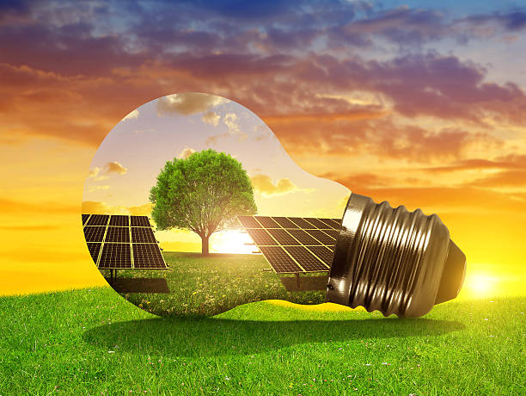
SOLAR ENERGY
Name – Md Rafiuddin
College Roll No. – 242440003
Course Name – PHYS
Semester – 1st
College Name – Krishna Chandra College
NAME: MD RAFIUDDIN
COLLEGE ROLL NO. : 242440003
COURSE NAME: PHYS
SEMESTER: 1ST
COLLEGE NAME: KRISHNA CHANDRA COLLEGE
GUIDANCE BY MANOJ SAHA

Slide 2
CONTENT
1. What is Solar Energy
2. Solar energy advantage and disadvantage
3. Application of solar thermal energy
4. Solar Cooker
5. Solar Cooker advantage and disadvantage
6. Solar electricity generation
7. Reference

Slide 3
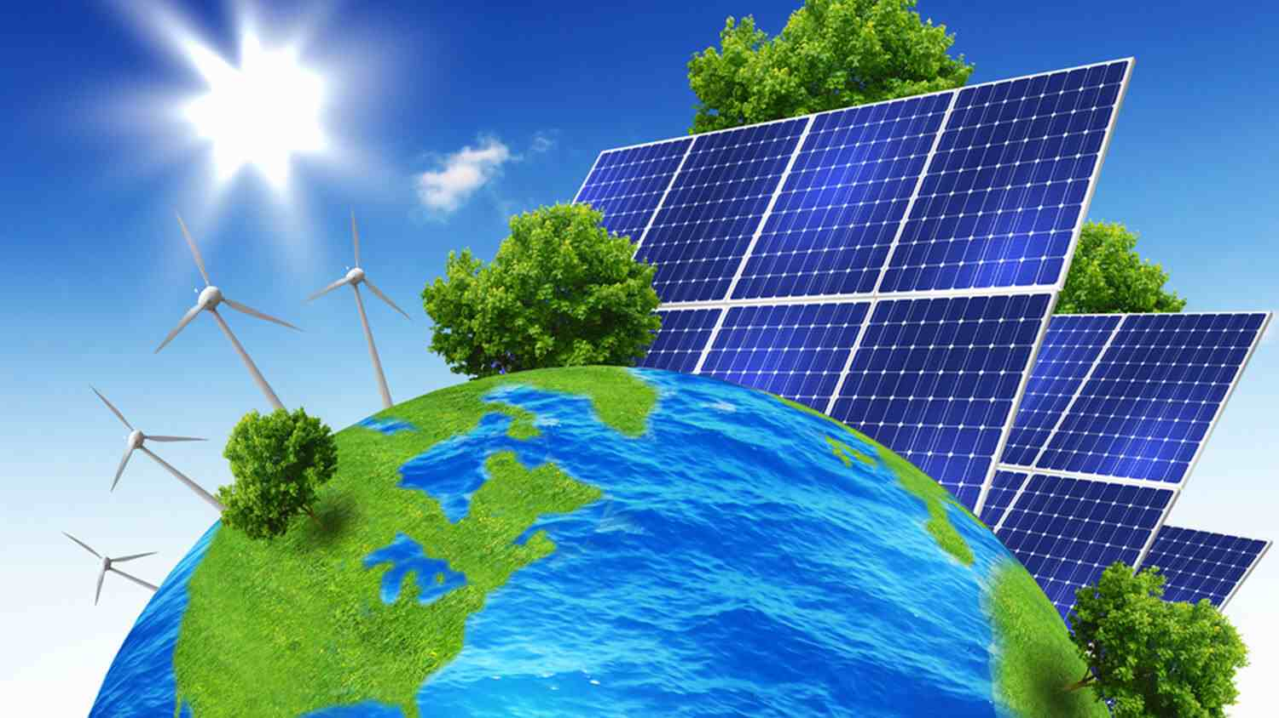
What Is Solar Energy?
Solar energy is a renewable
energy source. It’s the light and
heat from the sun that can be
captured and converted into
electricity or used for heating
or cooling.

Slide 4
SOLAR ENERGY ADVANTAGE & DISADVANTAGE
Advantage
Disadvantage
Renewable: Solar energy is a renewable energy source that comes from the sun's electromagnetic radiation. Renewable resources like solar energy won't run out, unlike fossil fuels.
Clean: Solar energy doesn't produce carbon emissions or other greenhouse gases. It also avoids the environmental damage of mining or drilling for fossil fuels.
Can save money: Solar panels can lower electricity bills.
Can increase home value: Solar panels can increase the value of your home.
Depends on sunlight: Solar panels depend on the availability and intensity of sunlight.
Requires cleaning: Solar panels require cleaning.
High initial costs: Solar panels can have high initial costs.
Land use: Large solar energy farms can lead to potential loss of habitat.

Slide 5
APPLICATION OF SOLAR THERMAL ENERGY
Solar thermal energy has many applications, including:
• Water heating: Solar water heaters use the sun's rays to heat water to temperatures between 60°C- 80°C. They are a sustainable alternative to conventional water heaters.
• Heating: Solar energy can be used to heat buildings, swimming pools, greenhouses, and livestock buildings.
• Cooking: Solar energy can be used for cooking.
• Power generation: Solar thermal energy can be used to generate electricity.
• Solar ponds: Solar ponds can be used to produce chemicals, food, and textiles.
• Thermal energy storage: Thermal energy storage involves heating or cooling a medium to use the energy later.

Slide 6
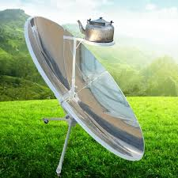
SOLAR COOKER
A solar cooker is a device which uses the energy of direct sunlight to heat, cook or pasteurize drink and other food materials.

Slide 7
SOLAR COOKER ADVANTAGE & DISADVANTAGE
Advantages
Pollution-free: Solar cookers don't produce smoke or ash and don't require fuel like coal, kerosene, electricity, or wood.
Cost-effective: Solar energy is free.
Nutritious: Food cooked in a solar cooker retains its nutrients.
Safe: Solar cookers are safe to use and don't cause injury.
Disadvantages
Time-consuming: Cooking food in a solar cooker takes longer than using a normal cooker.
Limited use: Solar cookers can't be used at night, during the rainy season, or during foggy winters.
Reflector adjustment: The direction of the reflector needs to be changed from time to time to keep it facing the sun.

Slide 8
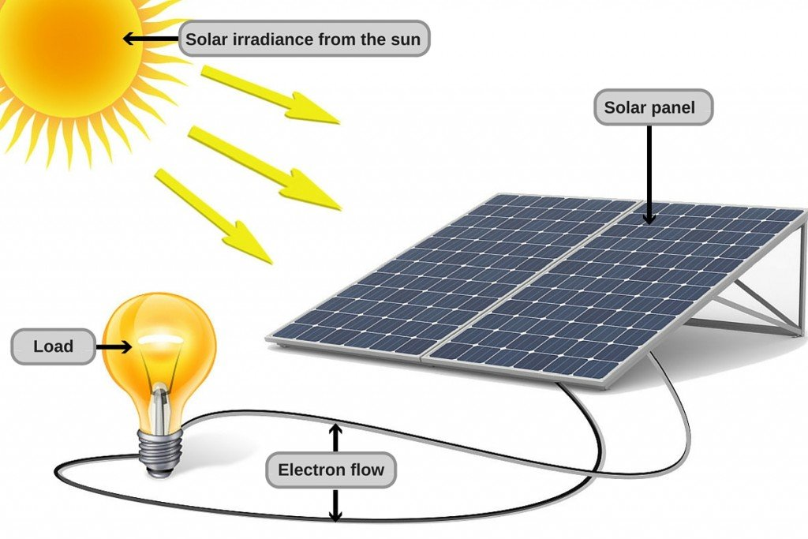
SOLAR ELECTRICITY GENERATION
Solar electricity generation is the process of converting sunlight into electricity using solar panels:
Absorb sunlight
Solar panels are made of photovoltaic (PV) cells that absorb photons, or packets of energy, from sunlight.
2. Create an electric charge
The absorbed energy creates an electric charge in the PV cells.
3. Produce an electric current
The electric charge creates an electric current, which is captured by the wiring in the solar panels.
4. Convert to alternating current
The direct current (DC) electricity produced by the solar panels is converted to alternating current (AC) by an inverter. AC is the type of electricity used in wall sockets.

Slide 9
REFERENCE
Books: Solar Energy, Gerard M Crawley,2016
Books: Solar Energy An Introduction , Michael E. Mackay, 2015
https://en.wikipedia.org/wiki/Solar_energy
https://byjus.com/physics/solar-energy-project/
https://en.wikipedia.org/wiki/Solar_energy
Lecture Notes: K.P. Sudheer, P.K. Suresh kumar, Sreekutty Suresh V, Greeshma K

Slide 10
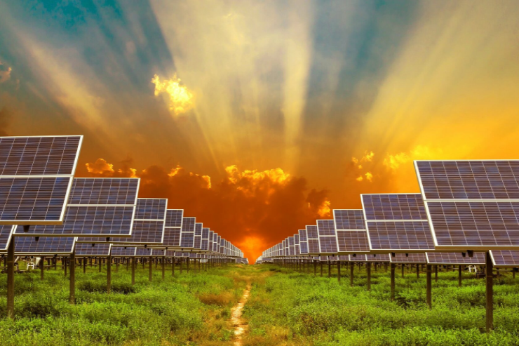
THANK YOU
HAPPY LIFE

